Slide 1

DAISY
Data Analysis and Information SecuritY Lab
Friend or Foe? Your Wearable Devices Reveal Your Personal PIN
Lead Researcher: Yingying Chen
Chen Wang†, Xiaonan Guo†, Yan Wang*, Yingying Chen†, Bo Liu†
†Dept. of ECE, Stevens Institute of Technology
* Dept. of CS, Binghamton University
Notes:
1

Slide 2
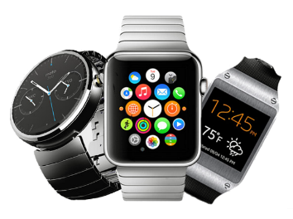
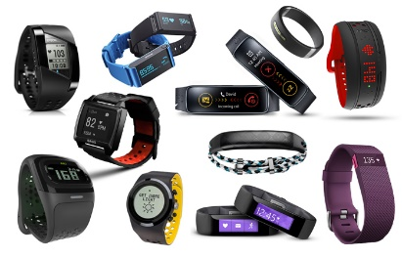

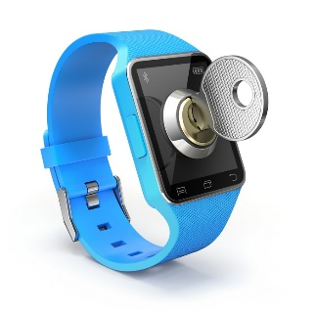

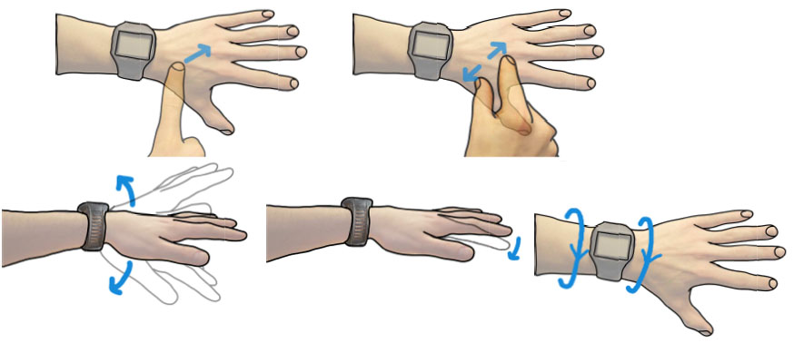
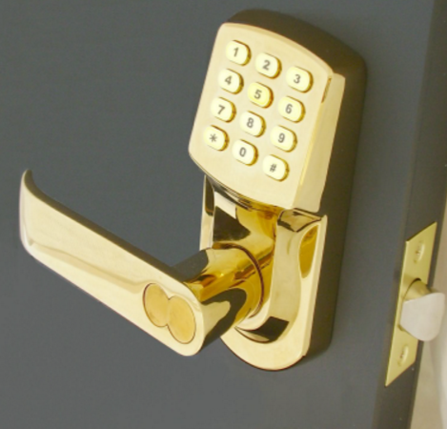
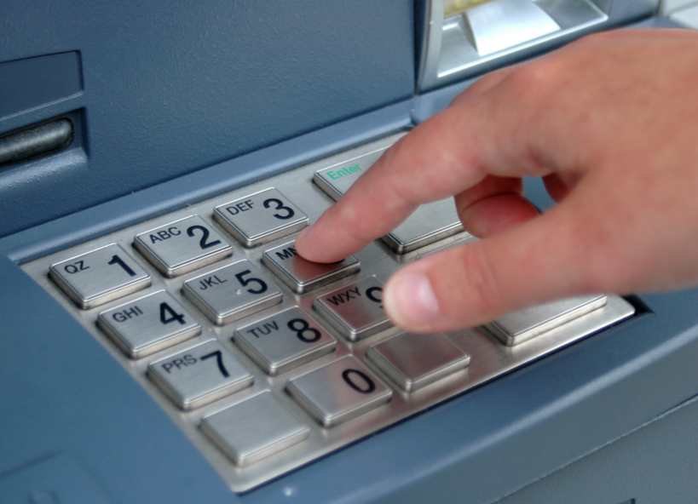
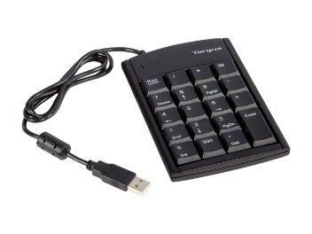
Motivation
Wearable device
Enable a broad range of useful applications
Sensitive information could be leaked
Electronic door lock
ATM machine
Keypad controlled server

Slide 3
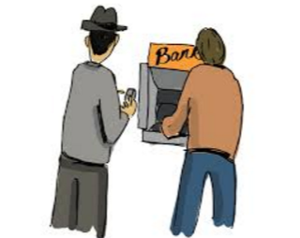
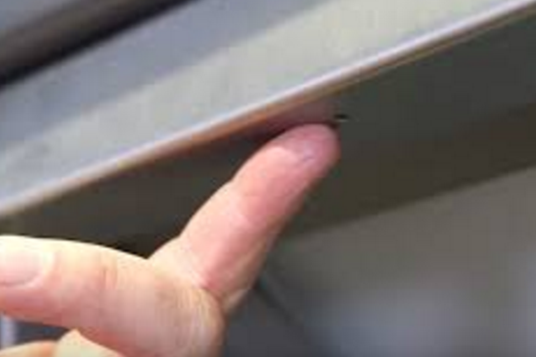
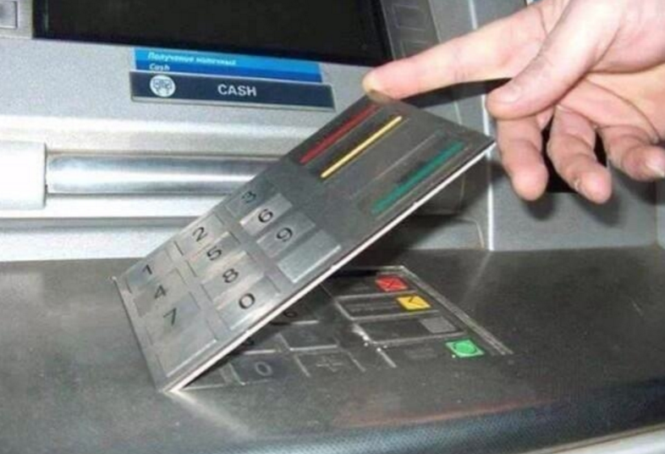
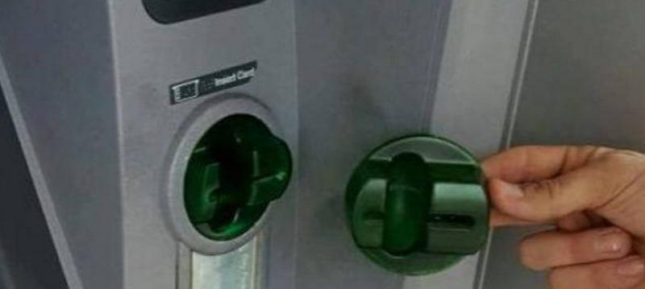


Related Work
Traditional attacks:
Audio-based and vibration-based attacks
Concurrent smartwatch-based attacks
  Hard to deal with non-contextual inputs such as PINs
  Rely on training.
  Difficult to recover fine-grained hand movement trajectories
Shoulder surfing
Hidden camera
Keypad overlay
ATM Skimmer
  Require direct visual contact to key entry actions and additional installation efforts
  Relies on a linguistic model and labelled training data Sensitive to environment noise
Our goal: Training-free and contextual-free key entry inference system without additional devices and not subject to environmental noises.

Slide 4
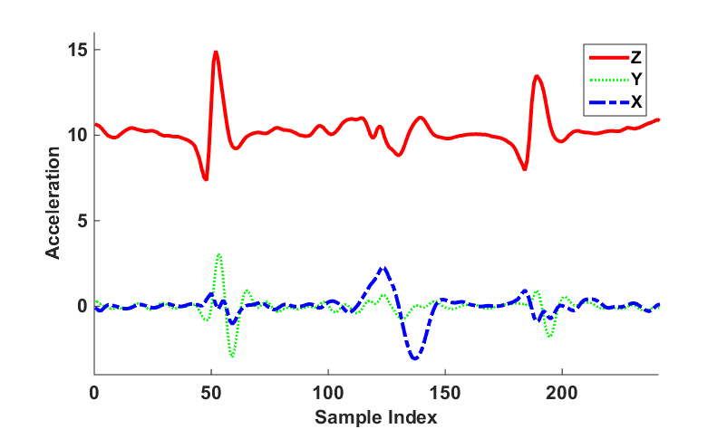

Basic Idea
Basic idea
  Exploit embedded sensors in wearable devices
  Capture dynamics of key entry activities
  Derive fine-grained hand movement trajectories of key entries.
Moving distance between two keys
Key click 1
Key click 2
Hand movement between two key clicks
Acceleration
Pressing point
Releasing point
Pressing point
Z
Key1
Key2
Y
X
Sample Index

Slide 5

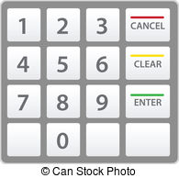






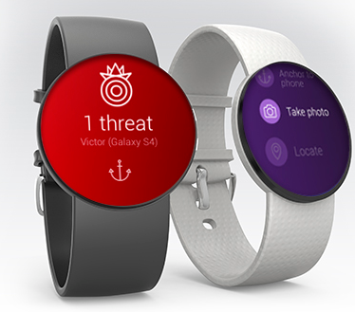


Attacking Scenarios
Sniffing attacks
Internal attacks
Device pairing using Bluetooth
Malwares
Bluetooth sniffing

Slide 6

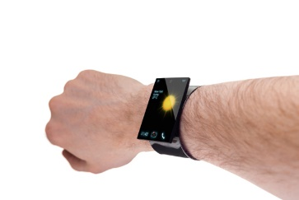

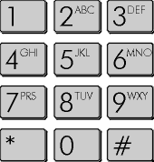


Challenges
Challenges
  Robust fine-grained hand movement tracking
  Training free key entry recognition
  Recovering PIN sequence without contextual information
  Sensing with single free-axis wearable device
Training Data
Y_{d}
Wearable
coordinate
Z_{d}
Y_{k}
Z_{k}
X_{d}
X_{k}
Keypad
coordinate

Slide 7
Framework Overview
Motion Sensor Readings
Key Click Detection and Trace Segmentation
Quaternion-based Coordinate Alignment
Data Calibration
Noise Reduction
Distance Estimation
Direction Derivation
Starting and End Point Searching
Quadrant Determination
Distance Calculation
Slope-based Angle Calculation
Fine-grained Subpath Recovery
Geometric-based Subpath Recovery
Key Pad Dimension
Backward Subpath Integration
Point-wise Euclidean Distance Accumulation
Backward PIN Sequence Inference
Tree based Key Sequence Derivation
Recovered key sequence

Slide 8

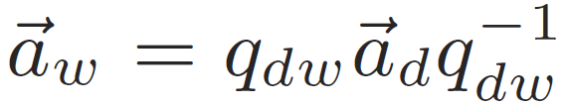



Quaternion-based Coordinate Alignment
Quaternion
Device coordinate
World coordinate
Keypad coordinate
Y_{d}
Z_{d}
Y_{d}
Y_{k}
Z_{k}
Z_{d}
Wearable
coordinate
X_{d}
X_{k}
World coordinate
Keypad
coordinate
X_{d}
Sensor reading in world coordinate
Sensor reading in device coordinate
Quaternion
conversion from the world coordinate to keypad coordinate

Slide 9
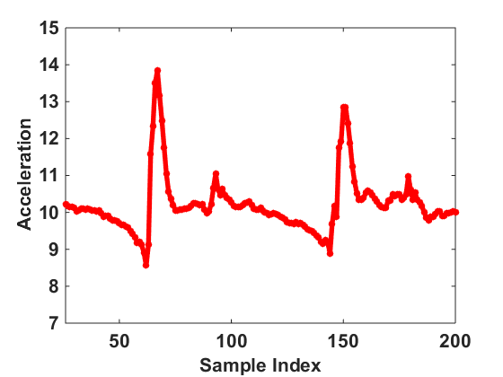
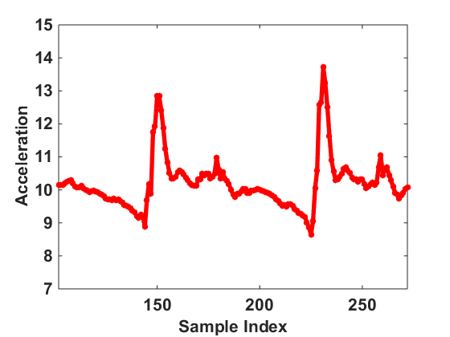
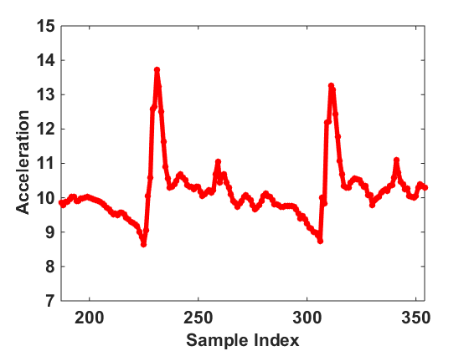
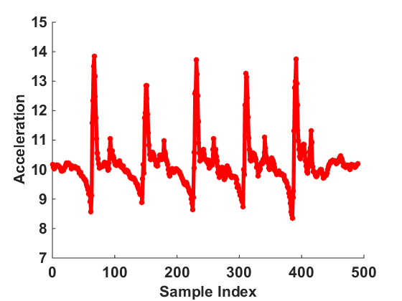
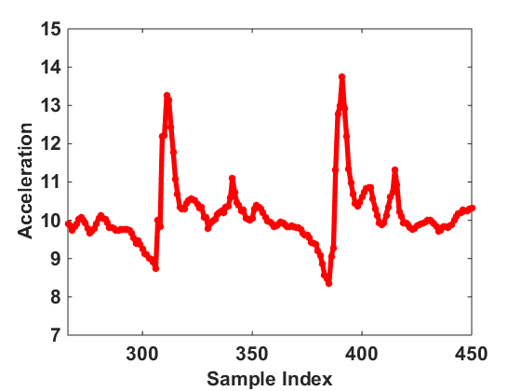
Fine-grained Subpath Recovery
Key-click trace segmentation
Input “5419-Enter”
Subpath recovery
1
2
Subpaths
3
1
2
3
4
4

Slide 10
Subpath Distance Estimation
Starting and ending points searching based on pressing and releasing points
Distance calculation
  Double integration with Trapezoidal rule
Starting point: first zero-crossing point before the unique acceleration pattern
Ending point: first zero-crossing point after the unique acceleration pattern

Slide 11
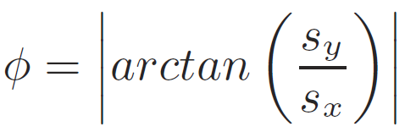

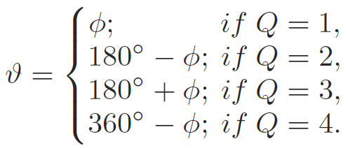
Subpath Direction Derivation
Y
Range 0º ~ 90º
X
Y
Q2
90º ~ 180º
Q1
0º ~ 90º
Quadrant Determination
X
Q3
180º ~ 270º
Q4
270º ~ 360º

Slide 12
Backward PIN Sequence Inference
Backward Subpath Integration
subpath1
1
2
3
Enter
4
5
6
subpath2
7
8
9
Estimated as“259”
0
Ground truth “419”
subpath3

Slide 13
Point-wise Euclidean Distance Accumulation
Example of candidate sequence 846
  The third subpath:
    d3= 1.2cm
    D3=d3=1.2cm
Key “Enter”
1
2
3
4
5
6
Subpath 3
d3=1.2cm
7
8
9
0
Estimated starting position of a subpath
Estimated subpath
Real key position
Subpath of candidate PIN sequence

Slide 14
Point-wise Euclidean Distance Accumulation
Example of candidate sequence 846
  The third subpath:
    d3= 1.2cm
    D3=d3=1.2cm
  The second subpath:
    d2=2.1cm
    D2=D3+d2=3.3cm
Key “Enter”
1
2
3
Subpath2
4
5
6
d2=2.1cm
d3=1.2cm
7
8
9
0
Estimated starting position of a subpath
Estimated subpath
Real key position
Subpath of candidate PIN sequence

Slide 15
Point-wise Euclidean Distance Accumulation
Example of candidate sequence 846
  The third subpath:
    d3= 1.2cm
    D3=d3=1.2cm
  The second subpath:
    d2=2.1cm
    D2=D3+d2=3.3cm
  The first subpath
    d1=0.8cm
    D1=D2+d1=4.1cm
Key “Enter”
1
2
3
d2=2.1cm
4
5
6
Subpath1
d3=1.2cm
7
8
9
d1=0.8cm
0
Estimated starting position of a subpath
Estimated subpath
Real key position
Subpath of candidate PIN sequence

Slide 16
Tree-based Key Sequence Inference
Root node
“ENTER” key
1
2
6
9
0
……
……
D(K₁)
D(K₂)
D(K₆)
D(K₉)
D(K₀)
1
4
0
1
0
D(K₁,K₆)
……
D(K₄,K₆)
……
D(K₀,K₆)
D(K₁,K₉)
……
D(K₀,K₉)
1
8
0
1
4
0
Leaf node
D(K₁,K₄,K₆)
……
D(K₈,K₄,K₆)
……
D(K₀,K₄,K₆)
D(K₁,K₁,K₉)
……
D(K₄,K₁,K₉)
……
D(K₀,K₁,K₉)
Minimum accumulated Euclidean distance
Revealed PIN sequence: “419”

Slide 17
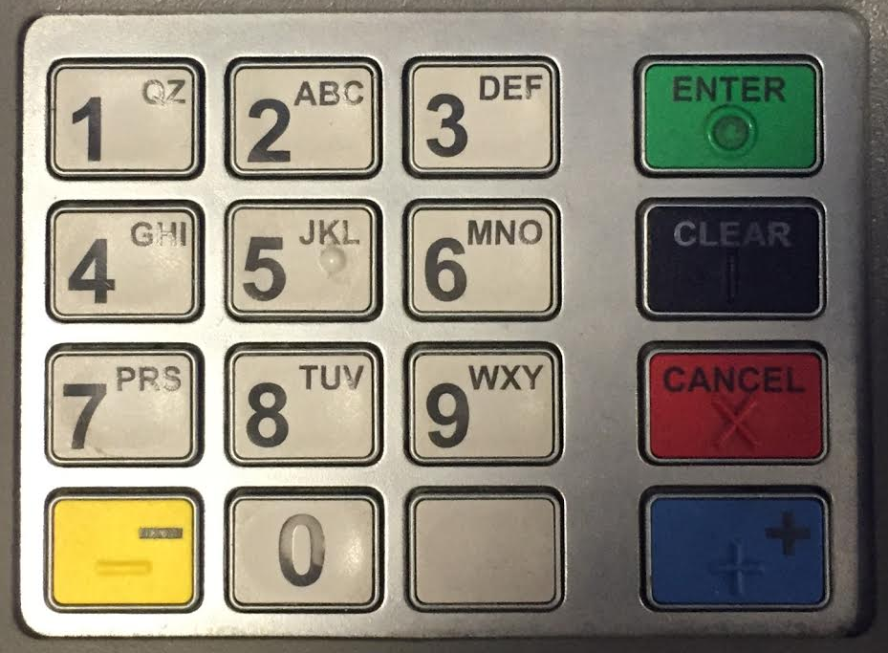
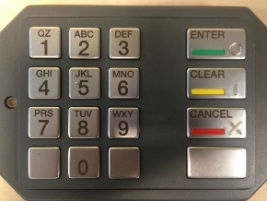
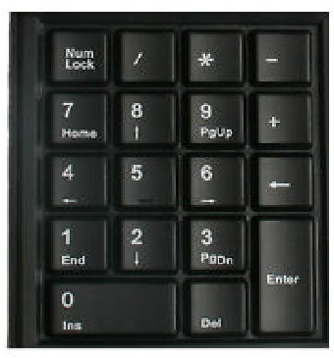
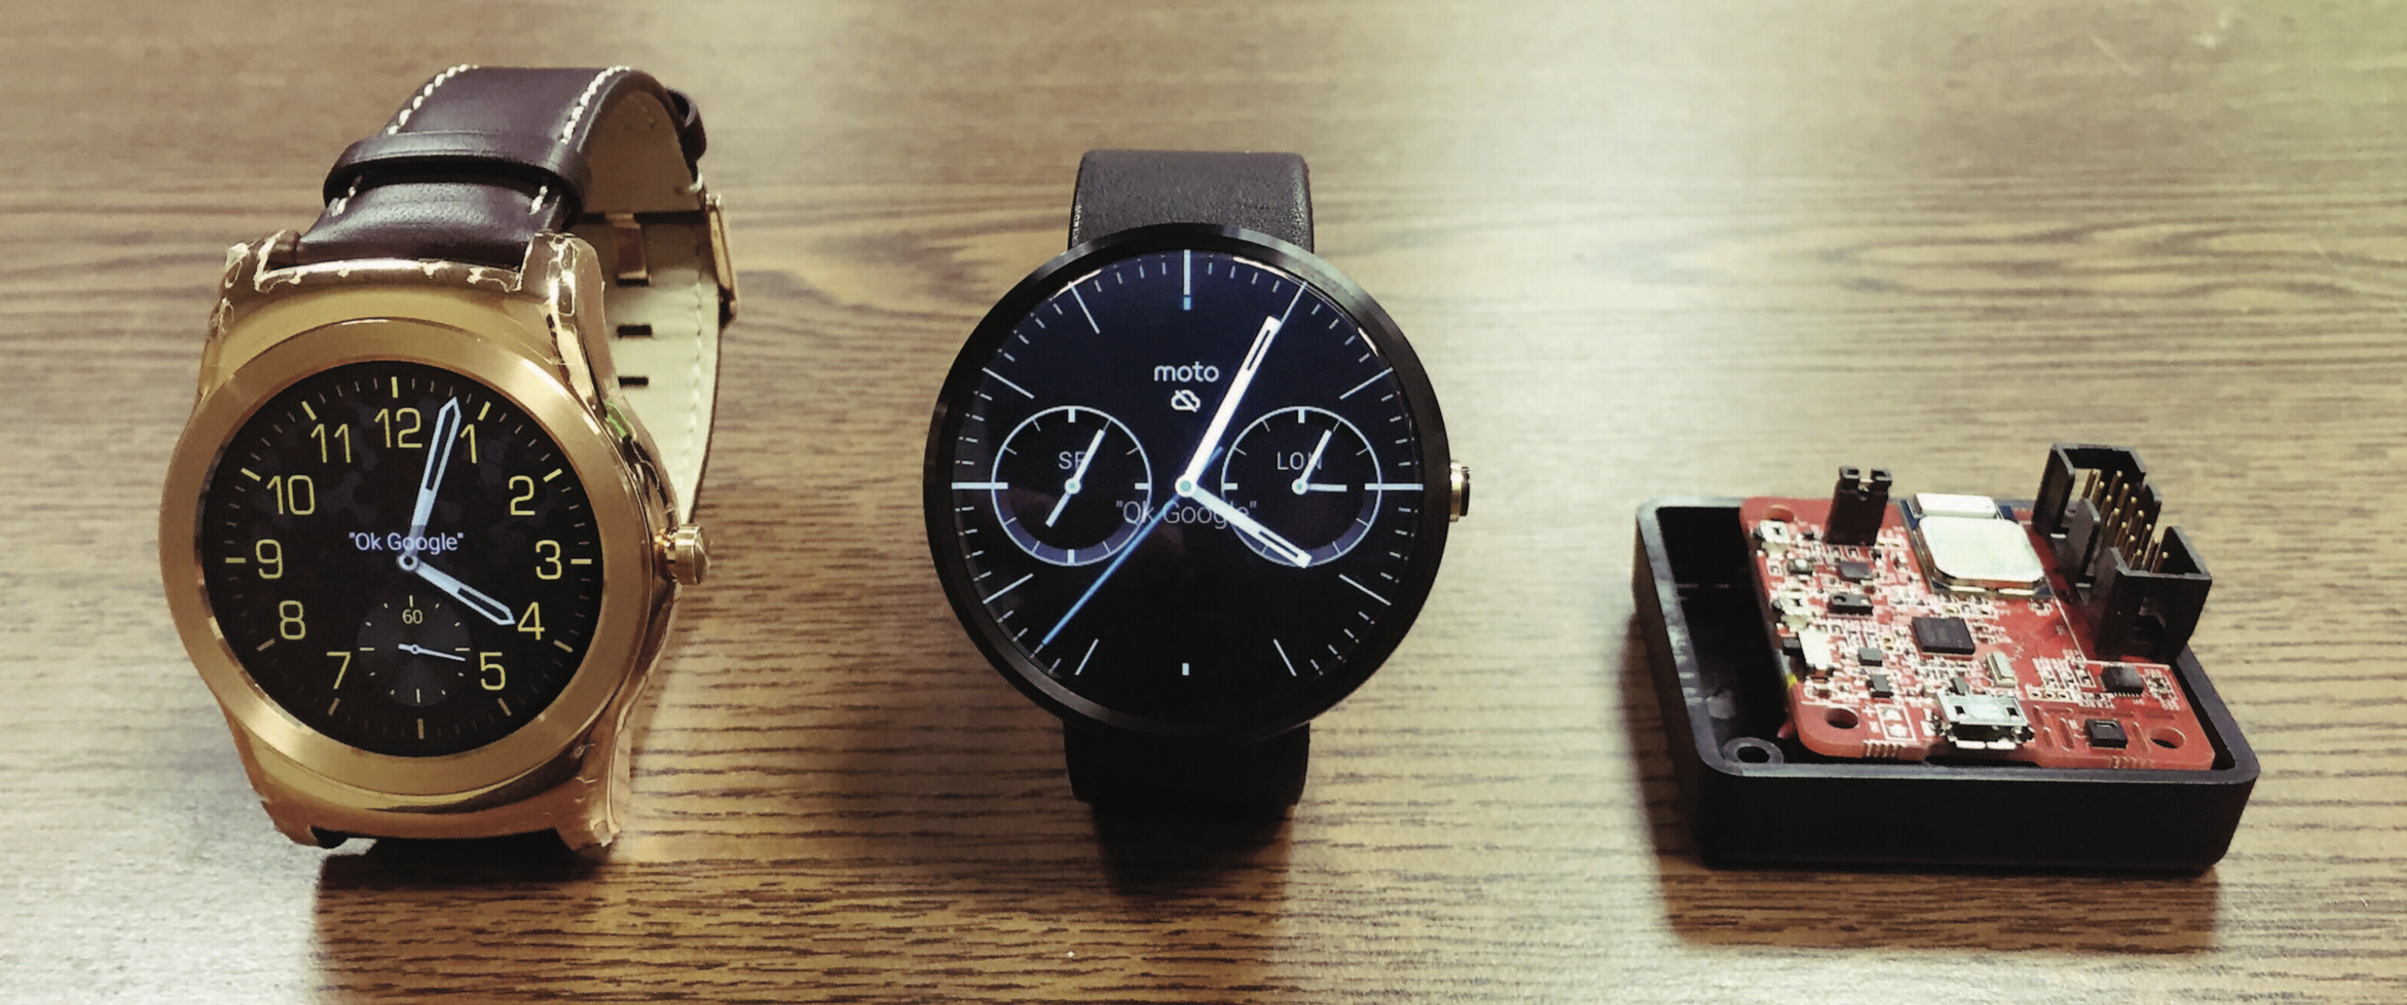
Experimental Methodology
Three Keypads
  Real ATM machine
  Detachable ATM pad
  Keyboard number pad
Three wearable Devices
  LG150 (200Hz)
  Moto360 (25Hz)
  Invensense MPU-9150 (100Hz)
Data collection
  Number of volunteers: 20
  Key-entry: 4-digit PIN sequences (5 key clicks)
Evaluation Metrics: Top-k success rate, number of trials until success
MPU-9150
LG 150
Moto 360

Slide 18
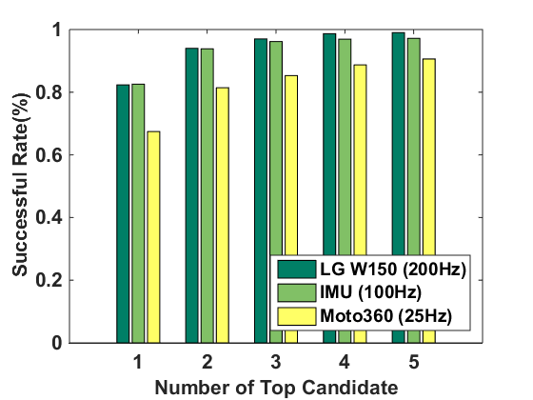
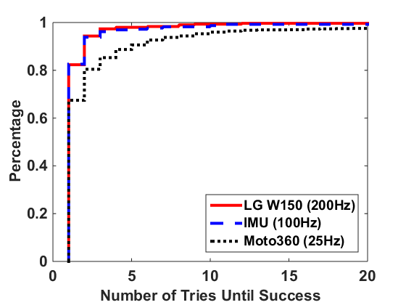
Performance of Different Wearable Devices
Performance of Backward PIN-Sequence Inference with three kinds of wearables on the detachable ATM Keypad
Higher sampling rate leads to higher successful rate
Adversary can break over 97% PIN entries from the LG W150 and IMU within 5tries. 90% for Moto 360.

Slide 19
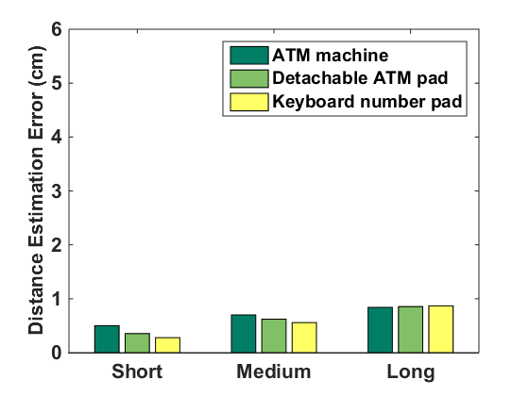
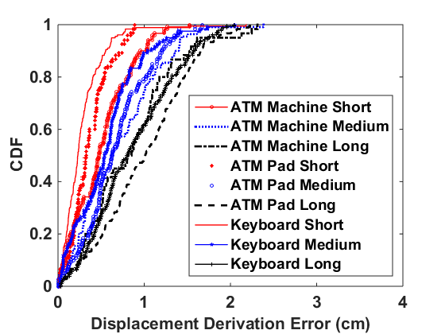
Distance Estimation
Fix 100 Hz sampling rate, testing 2.5cm (Short), 5cm (Medium) and 6.4cm (Long) moving distance
The mean error is only in mm-level
80th percentile errors
are less than 1.5cm

Slide 20
Conclusion
Wrist-worn wearable devices can be exploited to recover user’s fine-grained hand movements during key-entry activities
Present a PIN-sequence inference framework to recover the user’s secret key entries without requiring any training or contextual information
The system devises a Backward PIN-sequence Inference Algorithm to reveal user’s secret PINs
Extensive experiments show that our system can achieve high accuracy in revealing the user’s PIN sequences with one or within three tries

Slide 21



Slide 22
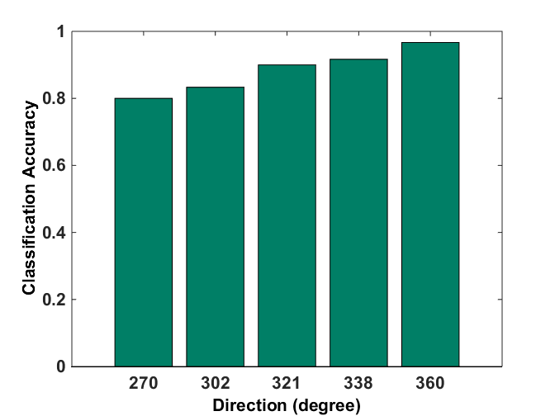
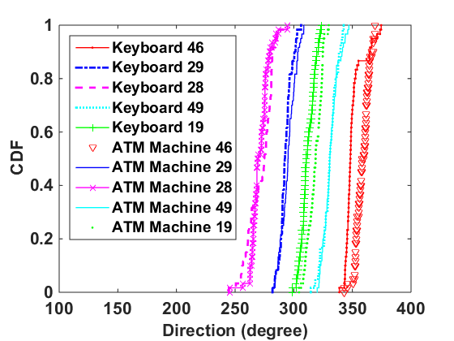
Direction Derivation Accuracy
Performance of distance estimation and direction derivation on three kinds of keypads under 100Hz sampling rate (IMU).
The classification results of direction is over 80%
90% of the derived directions are within ±10º to the ground truth

Slide 23
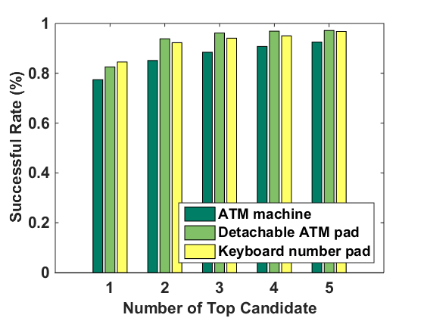
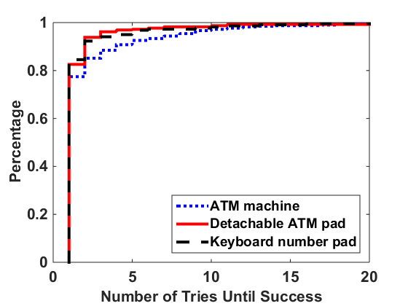
Performance of Different Keypads
Performance of PIN-sequence recovery on three different keypads by using medium sampling rate 100Hz (IMU)
More tries lead to higher successful rate and our algorithm is effective across different keypads

